Slide 1
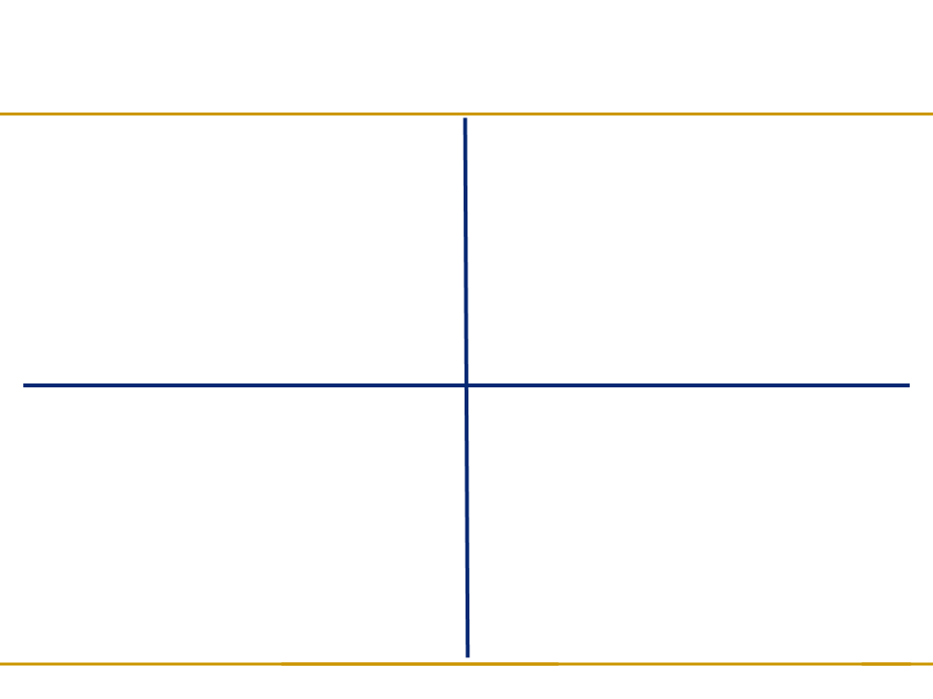


PROJECT FLYINGMOOSE
DESCRIPTION: An interactive checkers game that allows the user to hone their skills by trying to beat the computer or their friends
VALUE TO THE CUSTOMER:
  Can enjoy a game of checkers without having to manually reset the board and move pieces
  Can play checkers against the computer or against a friend
  Can keep track of performance/progress by referring to maintained win/loss statistics
  Hours of entertainment from one piece of software
OBJECTIVES:
  Provide an accurate and aesthetically pleasing representation of the classic board game, checkers, with simple controls, and intuitive click-to-move game-play mechanics.
  Allow the user to play against the computer (nonrandom artificial intelligence) or another human player
  Maintain user win/loss statistics so they can judge their overall performance
TECHNICAL APPROACH:
  Software written in Java using Eclipse IDE and Netbeans IDE GUI Builder
  Software opens as an executable JAR file
  User interfaces developed with the Java swing libraries
  Artificial intelligence uses a point-based system to weigh available moves to determine the best option
  Statistics and saved game configurations maintained in a text files stored within the project
Notes:
In summary, Project FlyingMoose offers a virtual checkers game experience, congruent with the standard US rules. It allows the user to play the classic game of checkers against the computer, which is powered by artificial intelligence, or against another human player. Project FlyingMoose maintains the user’s win and loss statistics separately for the two playing modes, which the user has the ability to reset if desired. This software is written in Java, and can be played on any system with a Java Virtual Machine. The game of checkers is easy to learn and fun to play—try out Project FlyingMoose today!

